Slide 1
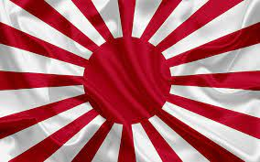
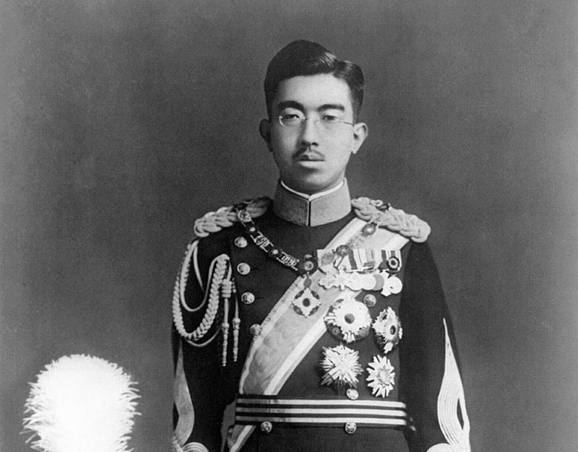
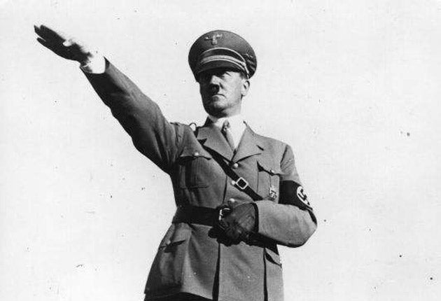
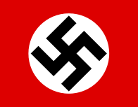
World War II
A War That Changed The Course Of History

Slide 2
What Lead Up To World War II
The Effects of World War I had destabilize Europe and many said that World War II grew out of issues that were left unresolved.
Hitler, who was originally an artist, had an idea and that was to make the German race pure “Aryan”.
He believed that the war was the only way to generate living space for the German or “Aryan” race.
Countries like United States, France and Great Britian were so focused on internal politics, that Hitler’s open aggression was left unchecked.

Slide 3
Countries Nazi Germany Invaded
Austria : Invading Austria was one of the countries that Hitler wanted to invade to expand the Germany.
Poland : Hitler wanted to take over Poland because he believed that his people had rights to greater territory and Poland had a lot of farmlands.
Soviet Union : In the beginning, the Soviet Union and Nazi Germany were allies but the Nazis were opposed to the ideas of the communist. Hitler believed he can defeat the Soviet Union but that failed horribly because it consisted of Ukraine, Russia, Belarus and many more.

Slide 4
Catastrophe of Nazi Germany
Nazi Germany has contributed to 39 million people being killed and half of them were civilians. Here is a list of people the Nazis killed:
6 Million Jewish People and 1.5 million of them were kids.
People with Disabilities
Homosexuals
Soviet Prisoners
Jehovah Witness

Slide 5
Nazi Execution Methods
The weak, ill and disabled people deported to special killing centers across Germany
The Soviet Prisoners of War were transported to camps for execution by Poison Gas

Slide 6
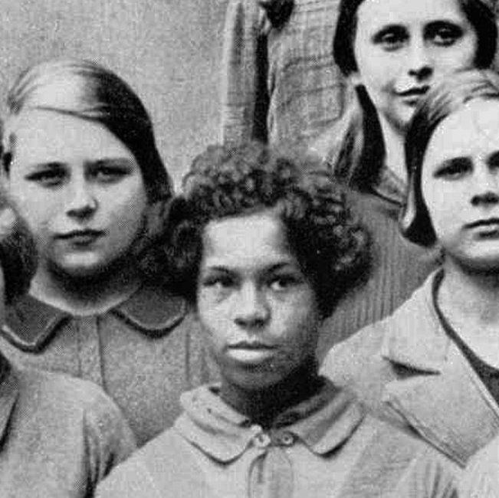
Shocking Revelation
There were recent reports of black people living in Nazi Germany. These people were persecuted during the time of Hitler and German Race. The Nazis believed that black people were non-Aryan and were inferior and poses danger to the health of the German Aryan population

Slide 7
Imperial Japan and Its Influence
Japan played a huge role in WWII. They invaded Guam, Wake Island and Hong Kong and some countries that were closed or around Japan.
When Japan invaded Thailand, they pressured its leaders to declare war on the United States and Great Britian.

Slide 8
Leading Up To Pearl Habor Bombing
The United States wanted to remain neutral in WWII, but Japan has pushed their buttons. The US placed economic sanctions which cause severe shortage of natural resources the Japanese needed to fund their war.
To prevent American interference, the Japanese decided to bomb Pearl Habor, a US Naval Station in Hawaii on December 7, 1941, as a surprise attack.
The US was angry because they killed over 2000 people and destroyed 19 navy ships.

Slide 9
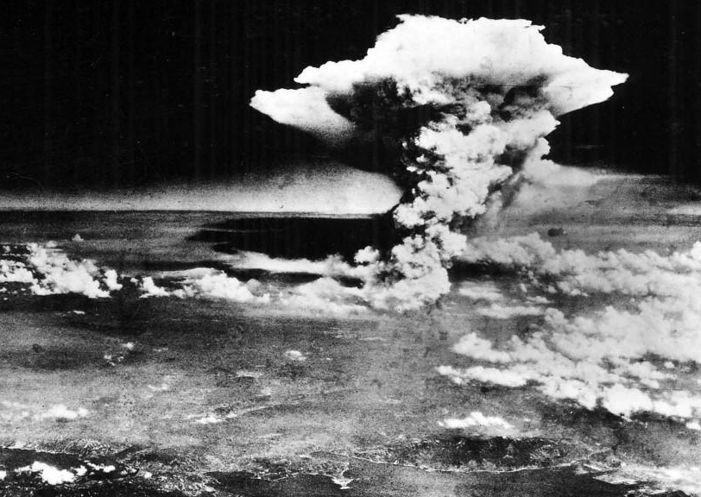
Atomic Bomb
On August 6, 1945, the US Air Force dropped the first atomic bomb on the Japanese city of Hiroshima which killed thousands of people.
The United State President, Harry Truman, warned the people to Japan to surrender to avoid destruction to their economy, family, home and nation.
The Japanese didn’t listen to the warning and 3 days later, the second Atomic bomb dropped on the city of Nagasaki.
It was estimated that 120,000 civilians died because of the 2 blasts.

Slide 10
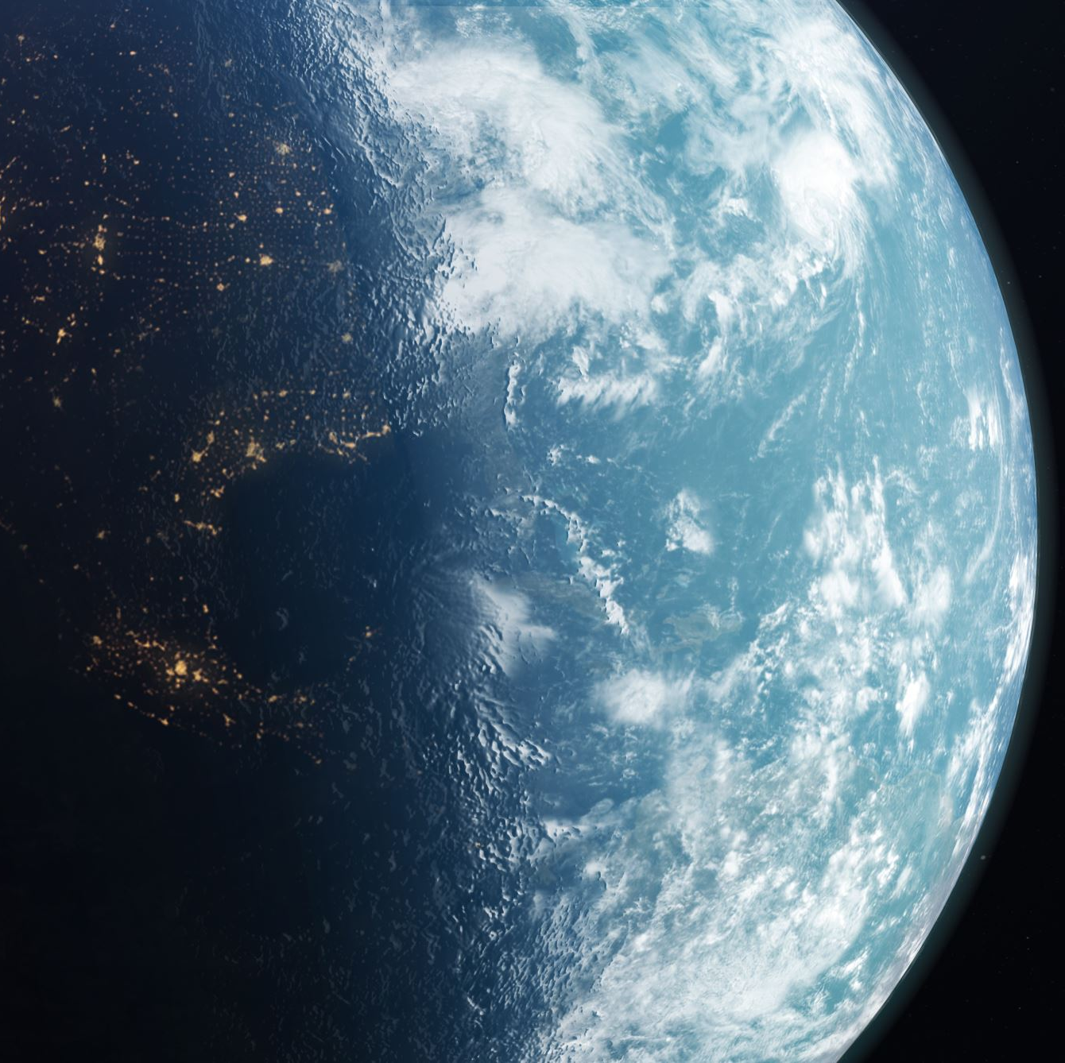
Conclusion
World War II was a global conflict that reshaped the World Order. The war’s end brought about geopolitical changes, the rise of new superpowers and the establishment of international institutions aimed at preventing future conflicts.

Slide 11

Thank You For Listening
Question Time

